Slide 1
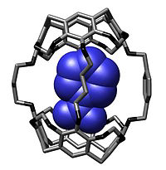
Molecular Encapsulation
ΠΑΠΑΔΑΚΗΣ ΜιχΑλης 938

Slide 2
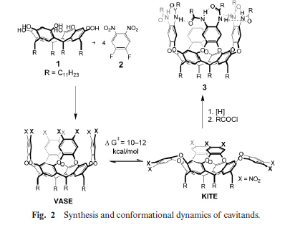
What is molecular encapsulation?
It’s a sub-category of self assembly
2 types of bonds between them
Guest and host interaction
Based on enzyme encapsulation

Slide 3
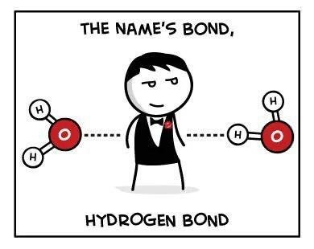
Bonds
The guest and host molecules interact with each other mainly through hydrogen bonds and ligand-like bonds.
The hydrogen bonds between them are weak and flexible
The ligand-like bonds are strong and stiff

Slide 4
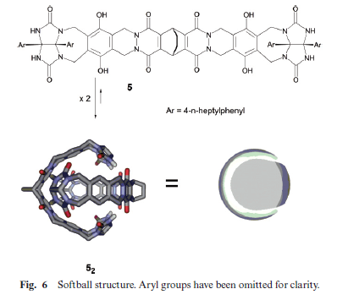
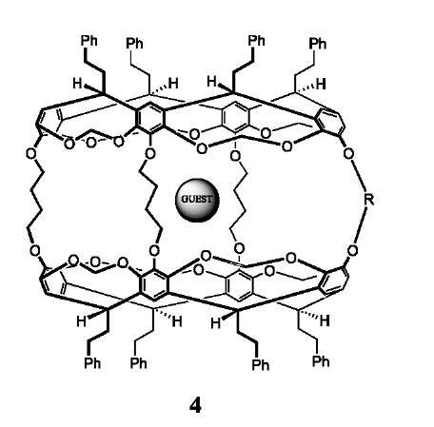
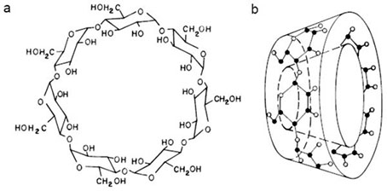
Types of host molecule
There are many shapes for a host molecule

Slide 5
MOFs in host-guest chemistry
Two main approaches for encapsulation
The ship-in-a-bottle approach is challenging for the assembly of guest molecules that require multiple post-synthetic operations
The de novo encapsulation approach does not have this limitation, but it requires that guest molecules not perturb MOF crystal growth and be compatible with the conditions used for MOF synthesis

Slide 6
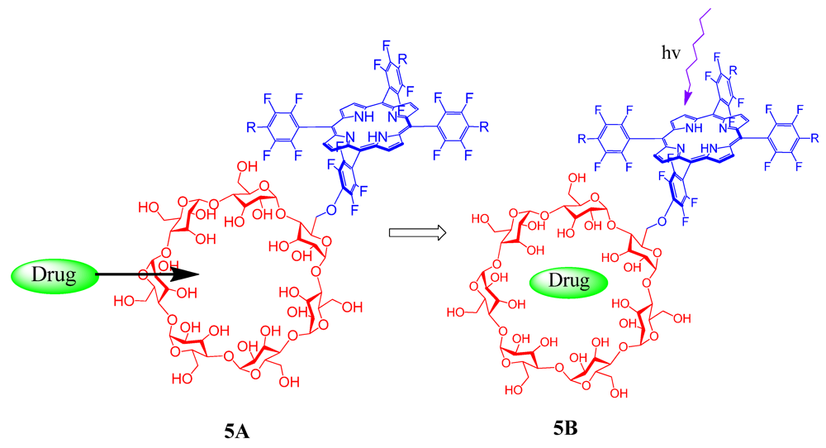
Applications
Isomeric discrimination of molecules
Isolation of unstable compounds
Drug delivery
Controlled reactions

Slide 7
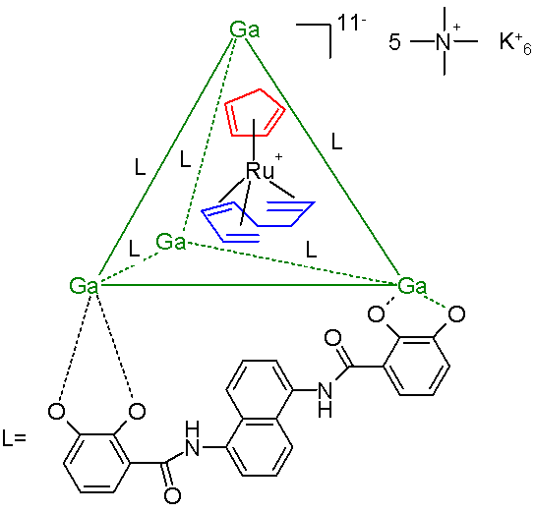
Encapsulation of ruthenium metallocene
Cage consisting of a gallium tetrahedral cluster compound stabilized by 6 bidentate catechol amide ligands residing at the tetrahedron edges
The ruthenium compound decomposes in water within minutes and in organic solutions within hours but encapsulated it survives in water for weeks.
Notes:
Large metalla-assemblies, known as metallaprisms, contain a conformationally flexible cavity that allows them to host a variety of guest molecules. These assemblies have shown promise as agents of drug delivery to cancer cells.
Κύκλοπενταδιένιο και 1,3,7-οκτατριένιο
Οργανομεταλλικός καταλύτης
Can react with CO will still encapsulated

Slide 8
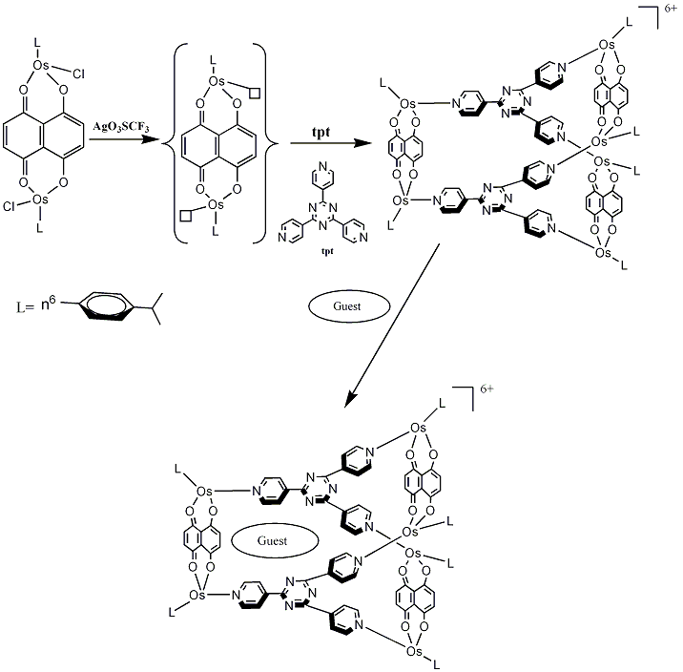
Coordination cage
Large metal-assemblies, known as metallaprisms, contain a flexible cavity that allows them to host a variety of guest molecules
These assemblies have shown promise as agents of drug delivery to cancer cells.
Notes:
Metallaprisms are a popular kind of coordination cage. In these compounds, six metal centres are linked with ligands to form an array of approximate D3h symmetry. They typically have conformationally-flexible cavities into which a variety of guest molecules bind.

Slide 9
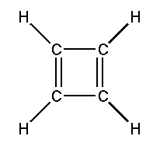
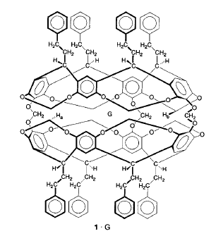
Encapsulation of Cyclobutadiene
Encapsulation of unstable cyclobutadiene at room temperature
Isolation of cyclobutadiene allowed chemists to experimentally confirm one of the most fundamental predictions of the rules of aromaticity

Slide 10
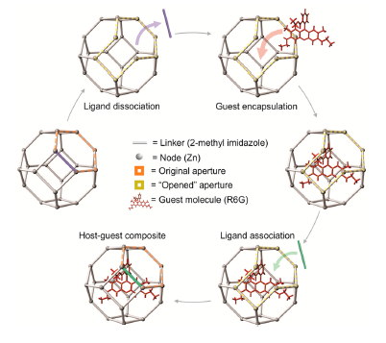
New way for MOF encapsulation
A part of the framework open for the entrance of the guest molecule and then the “door” closes again for the encapsulation
Notes:
2014
Incorporating functional guest molecules into the cavities of crystalline porous materials makes it possible to engineer these
materials for drug delivery, sensing, electrical conductivity, luminescence and energy conversion.

Slide 11
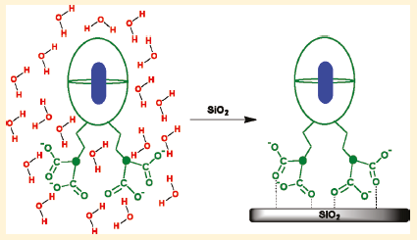
Capsular assemblies in aqueous solutions
The hosts form capsular assemblies in the presence of organic guest molecules in aqueous solution
It has been established that these host-guest assemblies could be transferred from solution to silica surface
Studies have been carried out for electron transfer between dye molecules included within cavitands and TiO₂ surface
The use of cavitands is believed to prevent dye aggregation and prolong the rate of back electron transfer
Notes:
Why the capsule doesn’t break and is held together on the SiO₂ surface

Slide 12
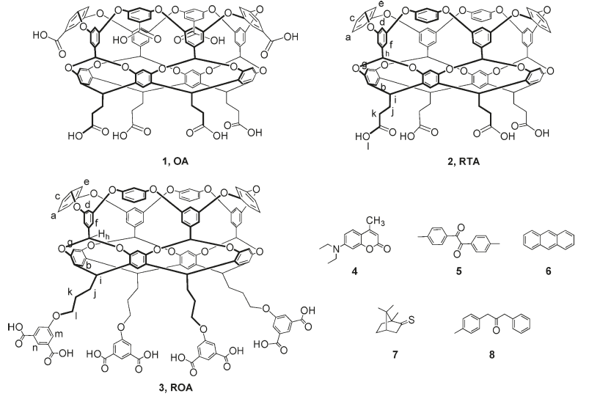

Slide 13
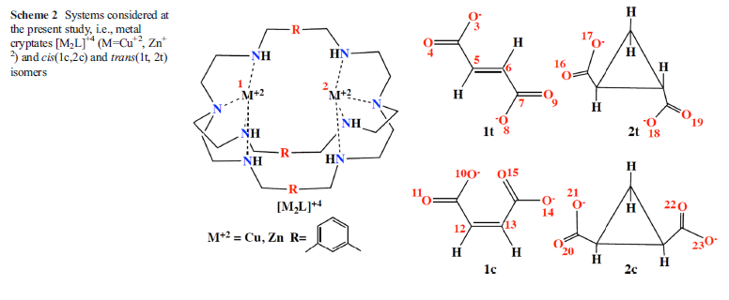
Separation of cis–trans isomers using dinuclear cryptates
Notes:
Fumarate binds more strongly to copper
In the case of cis and trans 1,2-cyclopropane dicarboxylate, the cis isomer binds more strongly to the copper cryptate
Dinuclear metal cryptates, particularly those which are zinc-based, may serve as very promising agents for isomeric separation and purification.

Slide 14
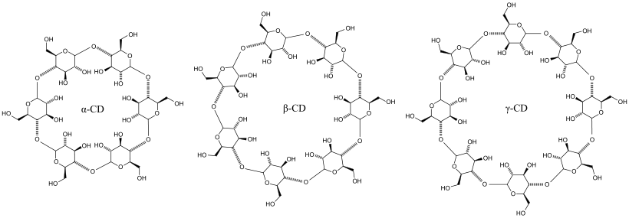
“Changing” from liquid to solid state
Alcohol can be molecularly encapsulated in cyclodextrines
Encapsuled in small capsules the fluid can be handled as a powder
The cyclodextrines can absorb an estimated 60 percent of their own weight in alcohol

Slide 15
Summary and future of encapsulation
Great technique for controlling reactions
Useful way to transfer molecules especially drugs
Good for isolating unstable compounds
The release of the guest must be studied further

Slide 16
References
Fiedler, D., Bergman, R. G., & Raymond, K. N. (2006). Stabilization of Reactive Organometallic Intermediates Inside a Self-Assembled Nanoscale Host**, 745–748.
Hof, F., Craig, S. L., Nuckolls, C., & Rebek, J. (n.d.). Molecular Encapsulation.
Morabito, J. V, Chou, L., Li, Z., Manna, C. M., Petro, C. A., Kyada, R. J., … Tsung, C. (2014). Molecular Encapsulation beyond the Aperture Size Limit through Dissociative Linker Exchange in Metal − Organic Framework Crystals.
Palmer, L. C., & Rebek, J. (2004). The ins and outs of molecular encapsulation, 3051–3059.
Psilbu, S., Wiberg, N., & Schuster, H. (1991). inner phase, 97(8), 1024–1027.
Ramasamy, E., Jayaraj, N., Porel, M., & Ramamurthy, V. (2012). Excited State Chemistry of Capsular Assemblies in Aqueous Solution and on Silica Surfaces, 10–16.
Semenova, M. (2017). Food Hydrocolloids Advances in molecular design of biopolymer-based delivery micro / nanovehicles for essential fatty acids. Food Hydrocolloids, 68, 114–121. https://doi.org/10.1016/j.foodhyd.2016.09.019

Slide 17
Bandaru, S., English, N. J., & Macelroy, J. M. D. (2014). Theoretical studies of separation of cis – trans isomers using dinuclear ( Cu 2 + - and Zn 2 + -based ) cryptates. https://doi.org/10.1007/s00894-014-2328-z
Manna, U., Chutia, R., & Das, G. (2016). Entrapment of Cyclic Fluoride − Water and Sulfate − Water − Sulfate Cluster Within the Self-Assembled Structure of Linear meta -Phenylenediamine Based Bis-Urea Receptors : Positional Isomeric E ff ect. https://doi.org/10.1021/acs.cgd.6b00205
Salavati-niasari, M., & Sobhani, A. (2008). Ship-in-a-bottle synthesis , characterization and catalytic oxidation of cyclohexane by Host ( nanopores of zeolite-Y )/ guest ( Mn ( II ), Co ( II ), Ni ( II ) and Cu ( II ) complexes of bis ( salicyaldehyde ) oxaloyldihydrazone ) nanocomposite materials, 285, 58–67. https://doi.org/10.1016/j.molcata.2008.01.030

